Slide 1
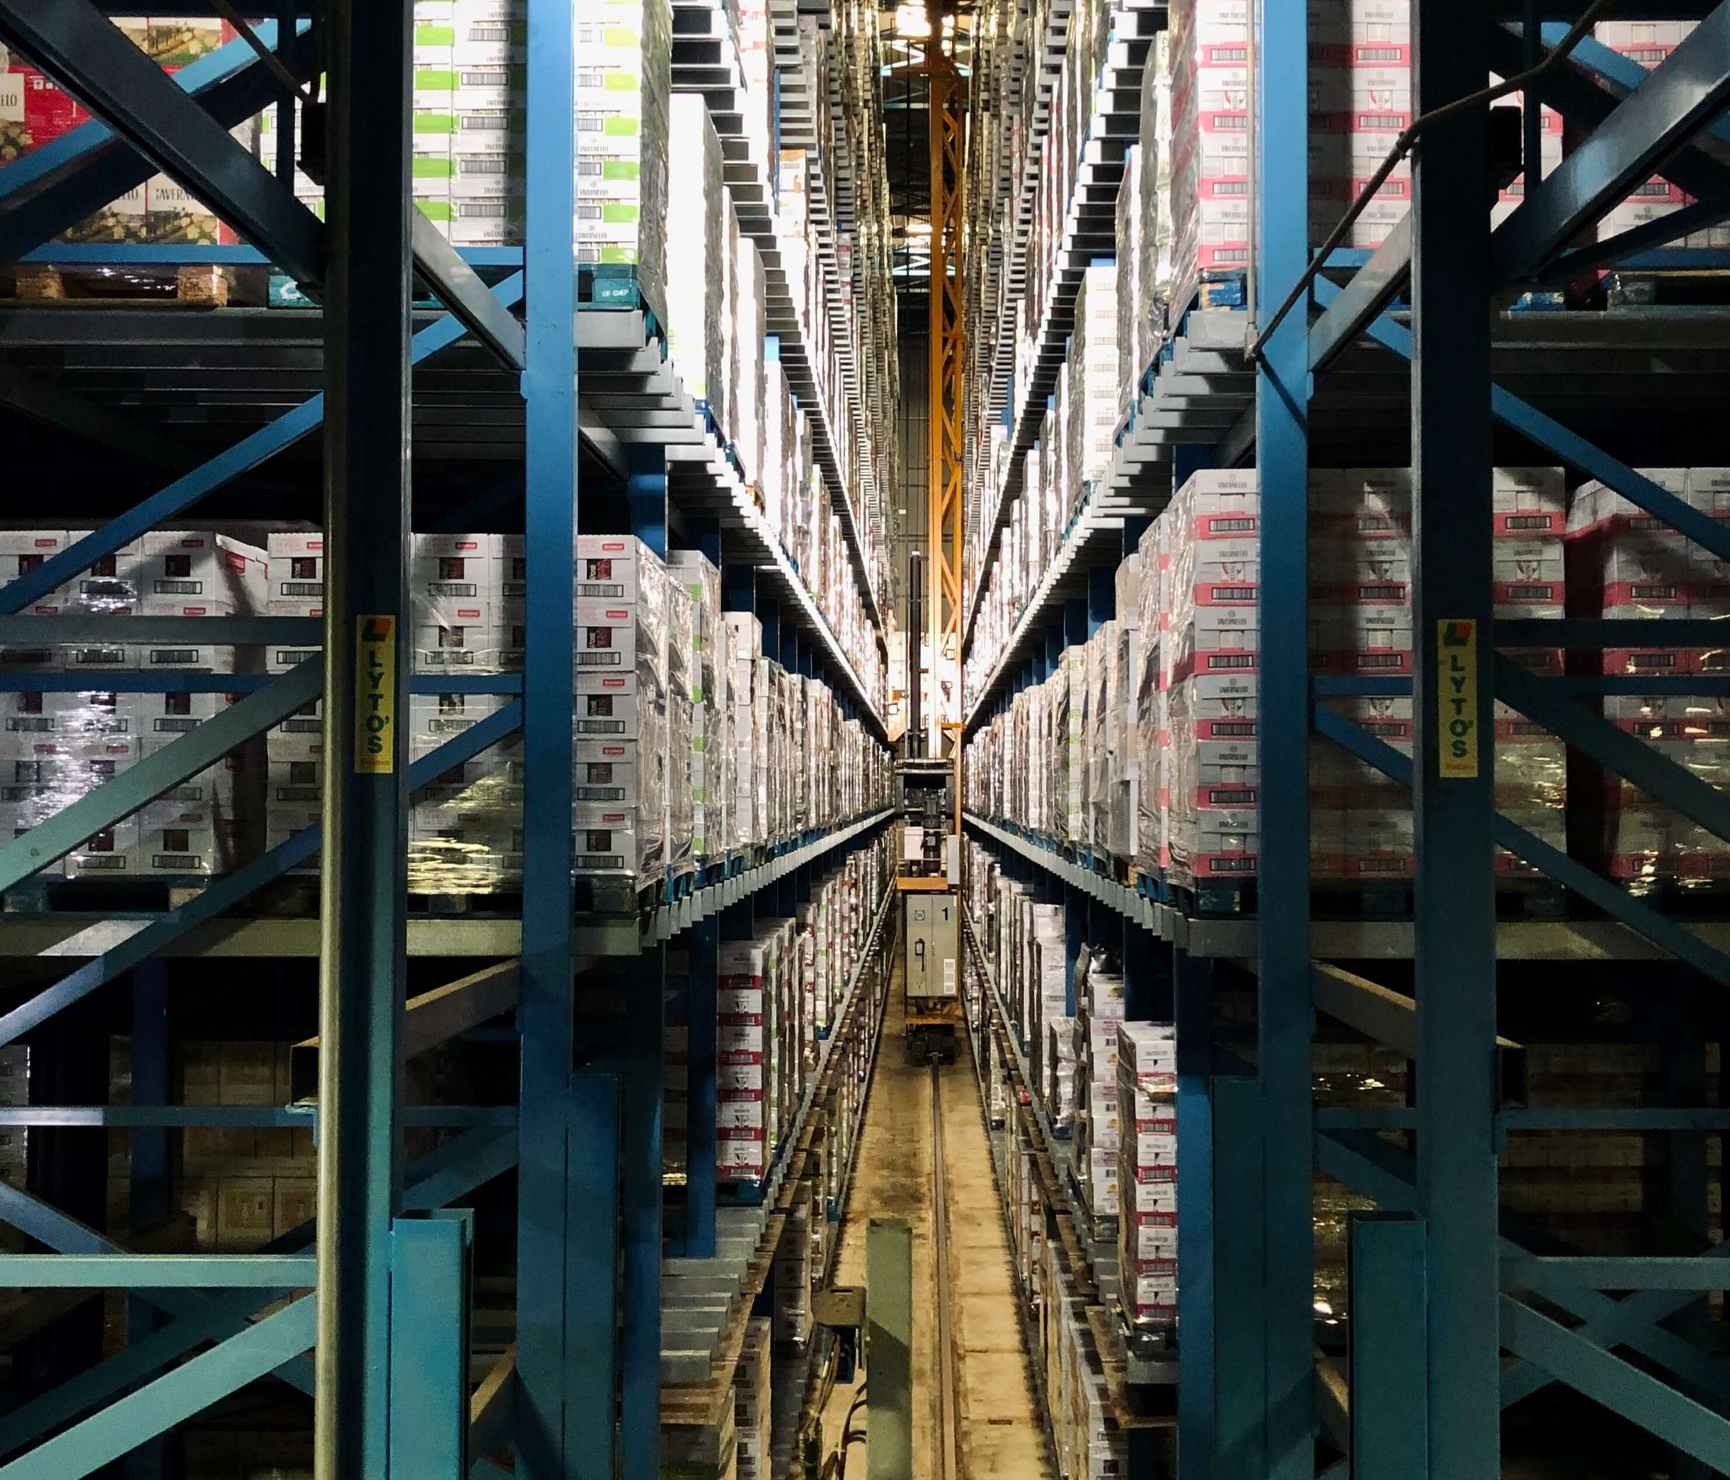


Slide 2
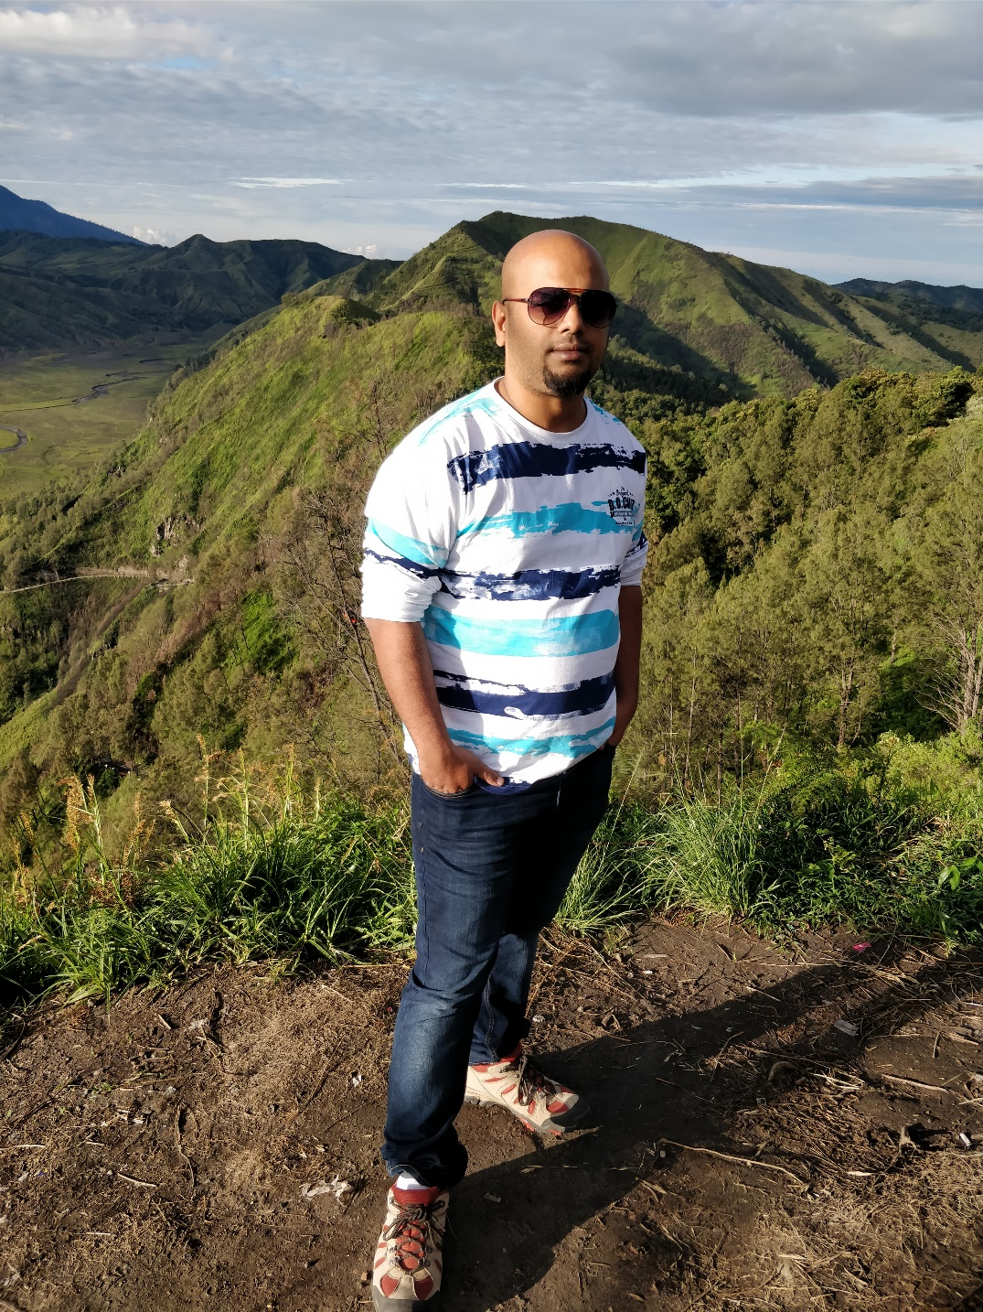


Team Members
Mykola “Neo” Zhabko - http://www.cc.puv.fi/~e2000594/
Ngoc “Trinity” Tran - http://www.cc.puv.fi/~e2000596/assignment/
Kunal “Morpheus” Menon - http://www.cc.puv.fi/~e2002009

Slide 3
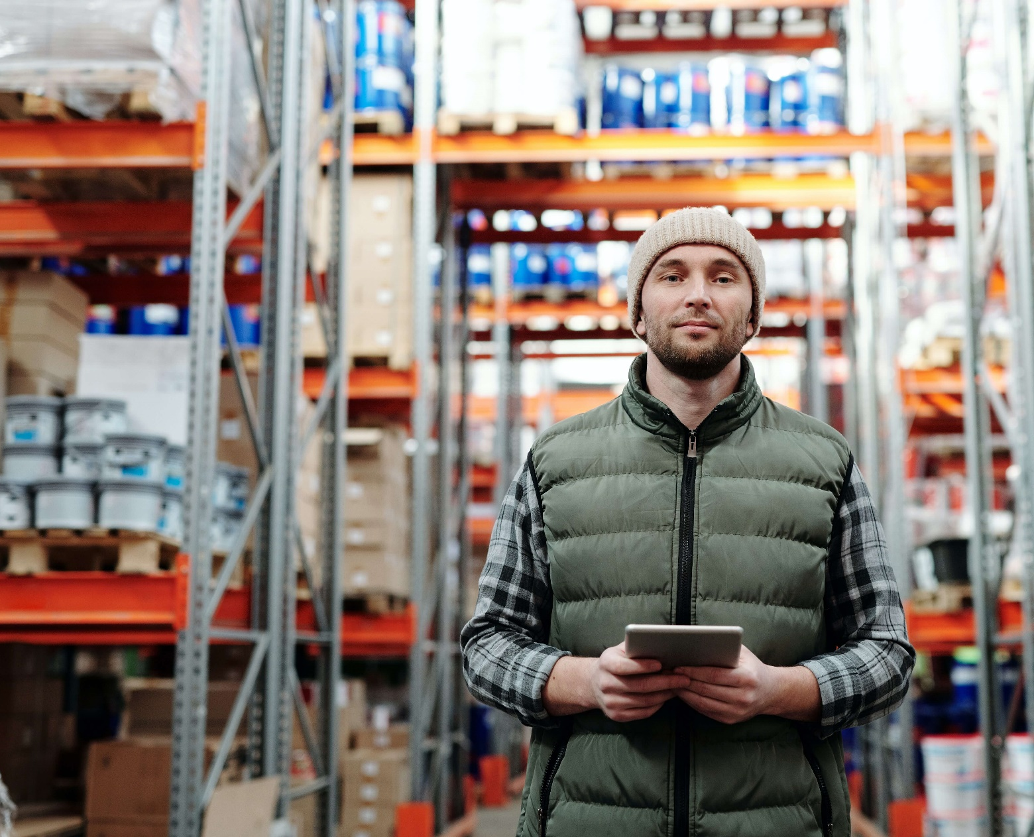
Requirements
We have a middle-sized wholesaler, who sells spare parts for machines. Their customers are ordering the spare parts via web shop, which is integrated into the shop ordering system. Order has following information: order id, customer id, customer name, invoicing address, delivery address, delivery date, responsible sales person, free comments, total price and list of ordered products. Product has following information: code, name, description, supplier code, quantity, unit price and shelf position.
In current situation, customer prints order in PDF-format from the order system. This paper is used in collecting ordered products from the warehouse. SO customer opens the ordering system, finds the order (there are different search criteria's, for example customer number, order id, delivery date etc). After opening the order, he prints the PDF and starts collecting the products. During the collection customer marks to paper which products he has picked, and giving comments for products. After all products have been picked, customer sends the products to their customer, and adds this PDF (which has lots of these internal markings done) into the packet. There are always questions from foreign customers, what does this and that marking mean.
Now the customer wants to start a new decade and get rid of the printed papers and pens. He contacts you and wants to start a co-operation with your team. Customer has decided to purchase a tablet into warehouse. With that tablet they want to use our application for product picking. Still user needs to be able to search orders with different criteria's, and once opening order to see what has been ordered. Users needs to be able to mark each product as picked and/or write comments on ordered products. After all products have been picked, user needs to be able to mark the whole order as ”ready”. He also needs to be able to print a clean packing list to be sent with the products. Marking the order as ready is important so that sales person sees the status and can answer customer questions. Our application needs to be secure, so login into the application is required.

Slide 4
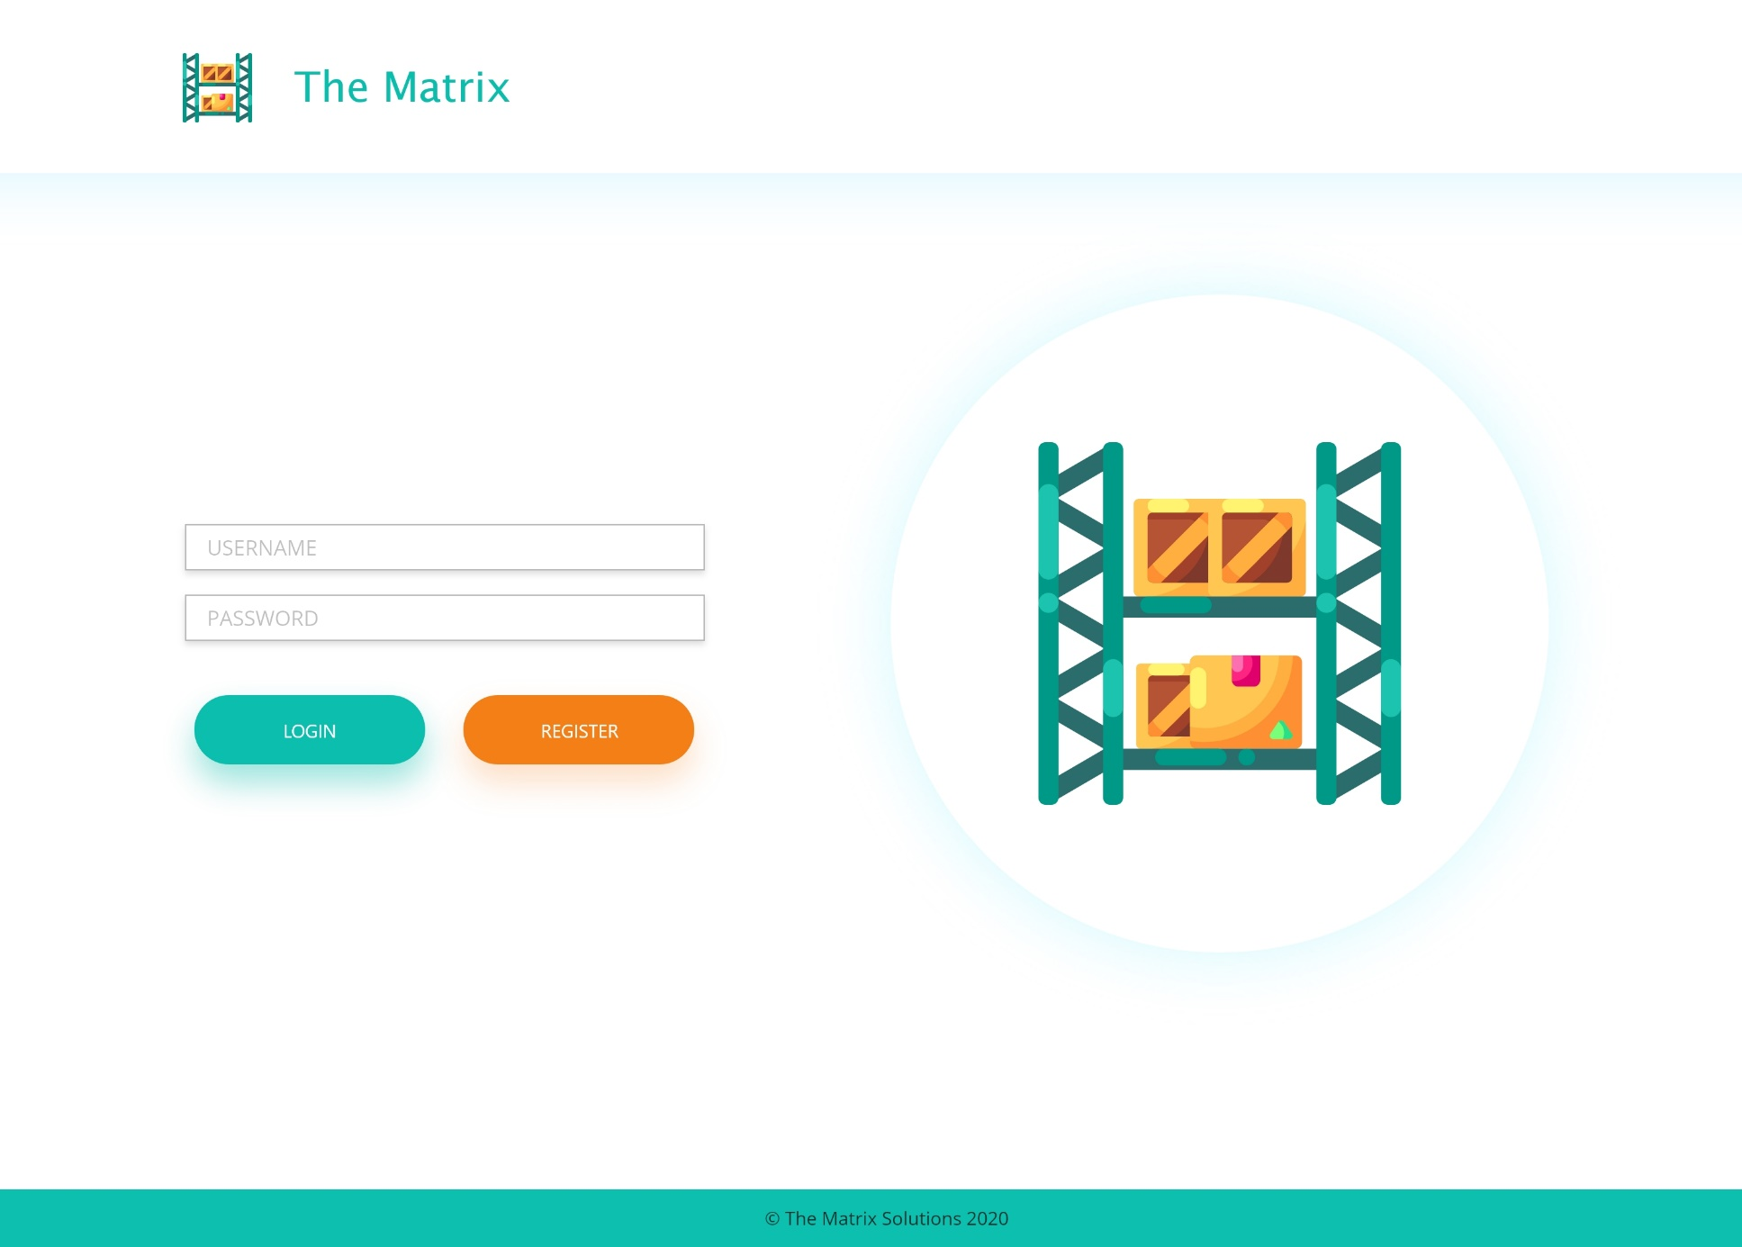
MOCKUP
LOGIN
PAGE

Slide 5
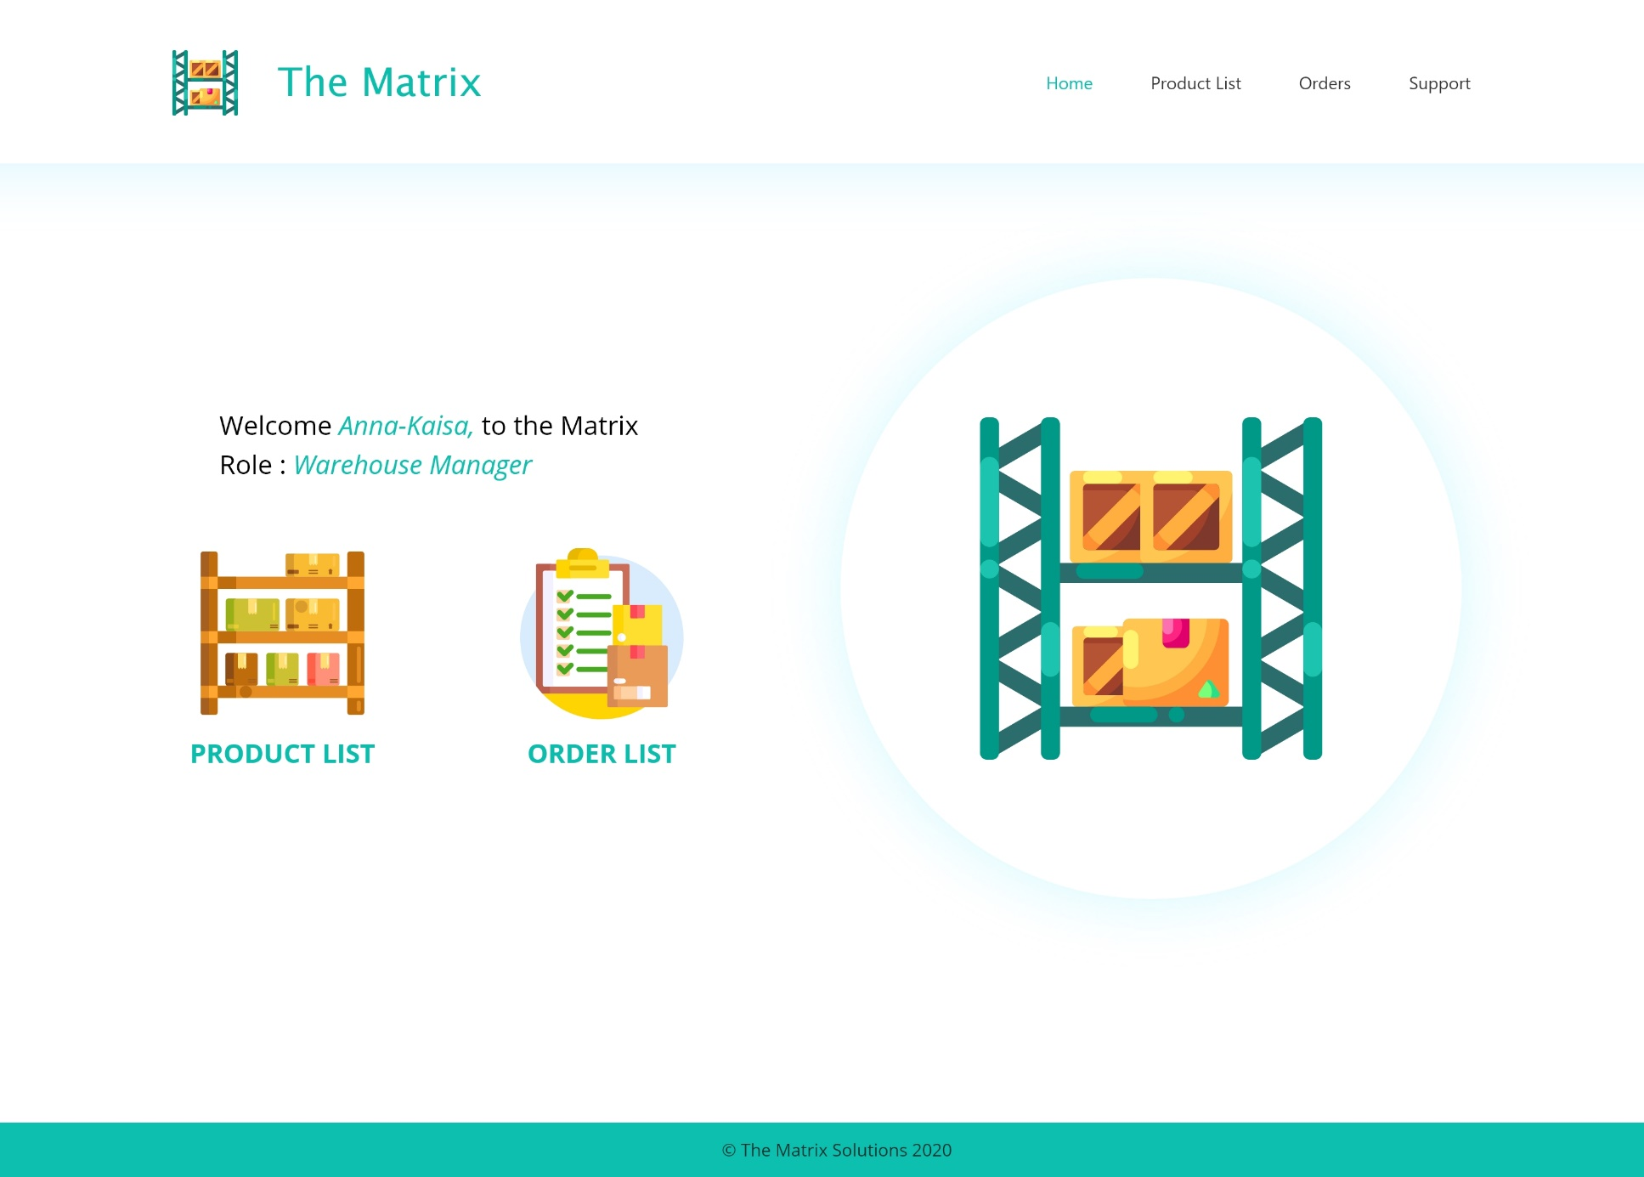
MOCKUP
LANDING
PAGE

Slide 6
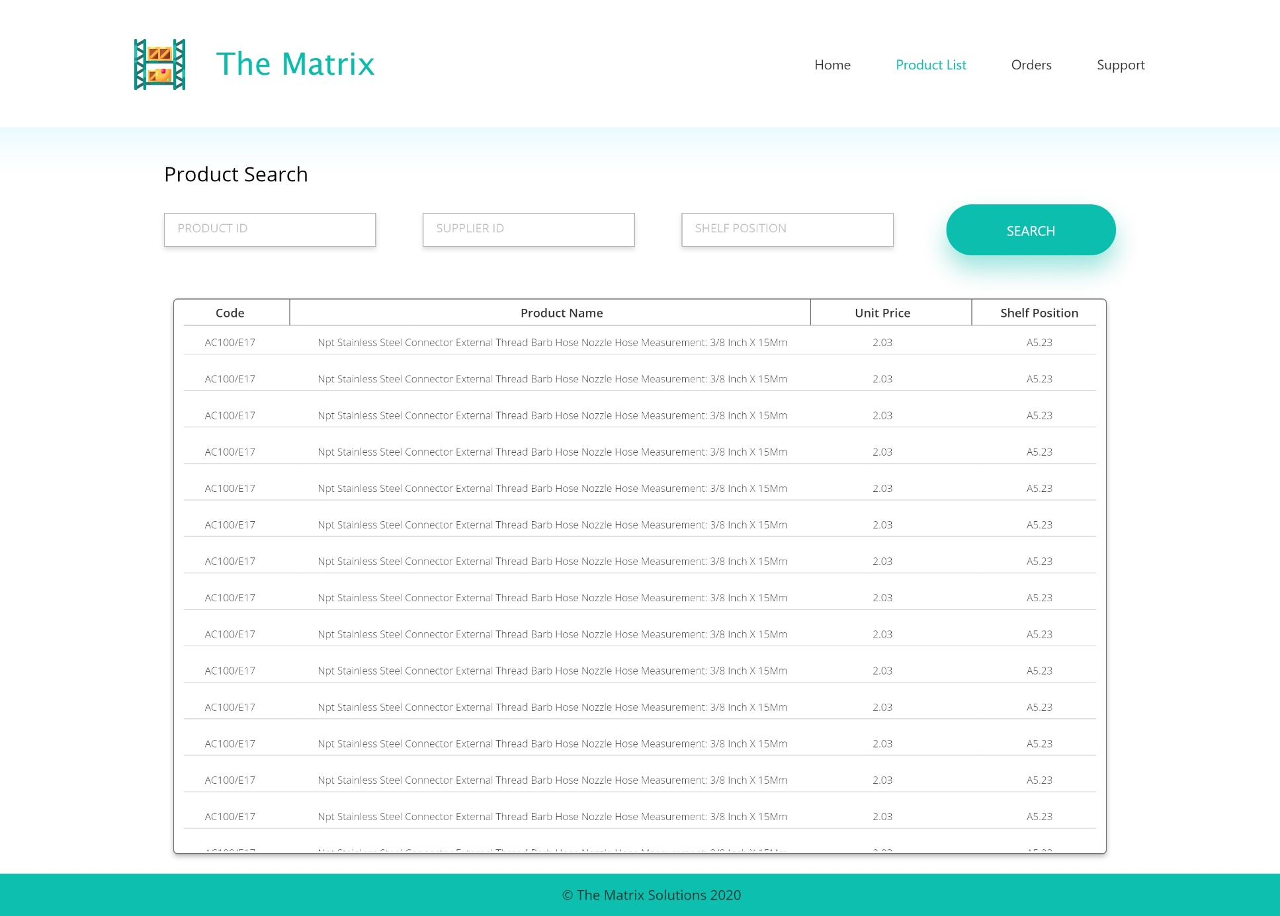
MOCKUP
PRODUCTS
PAGE

Slide 7
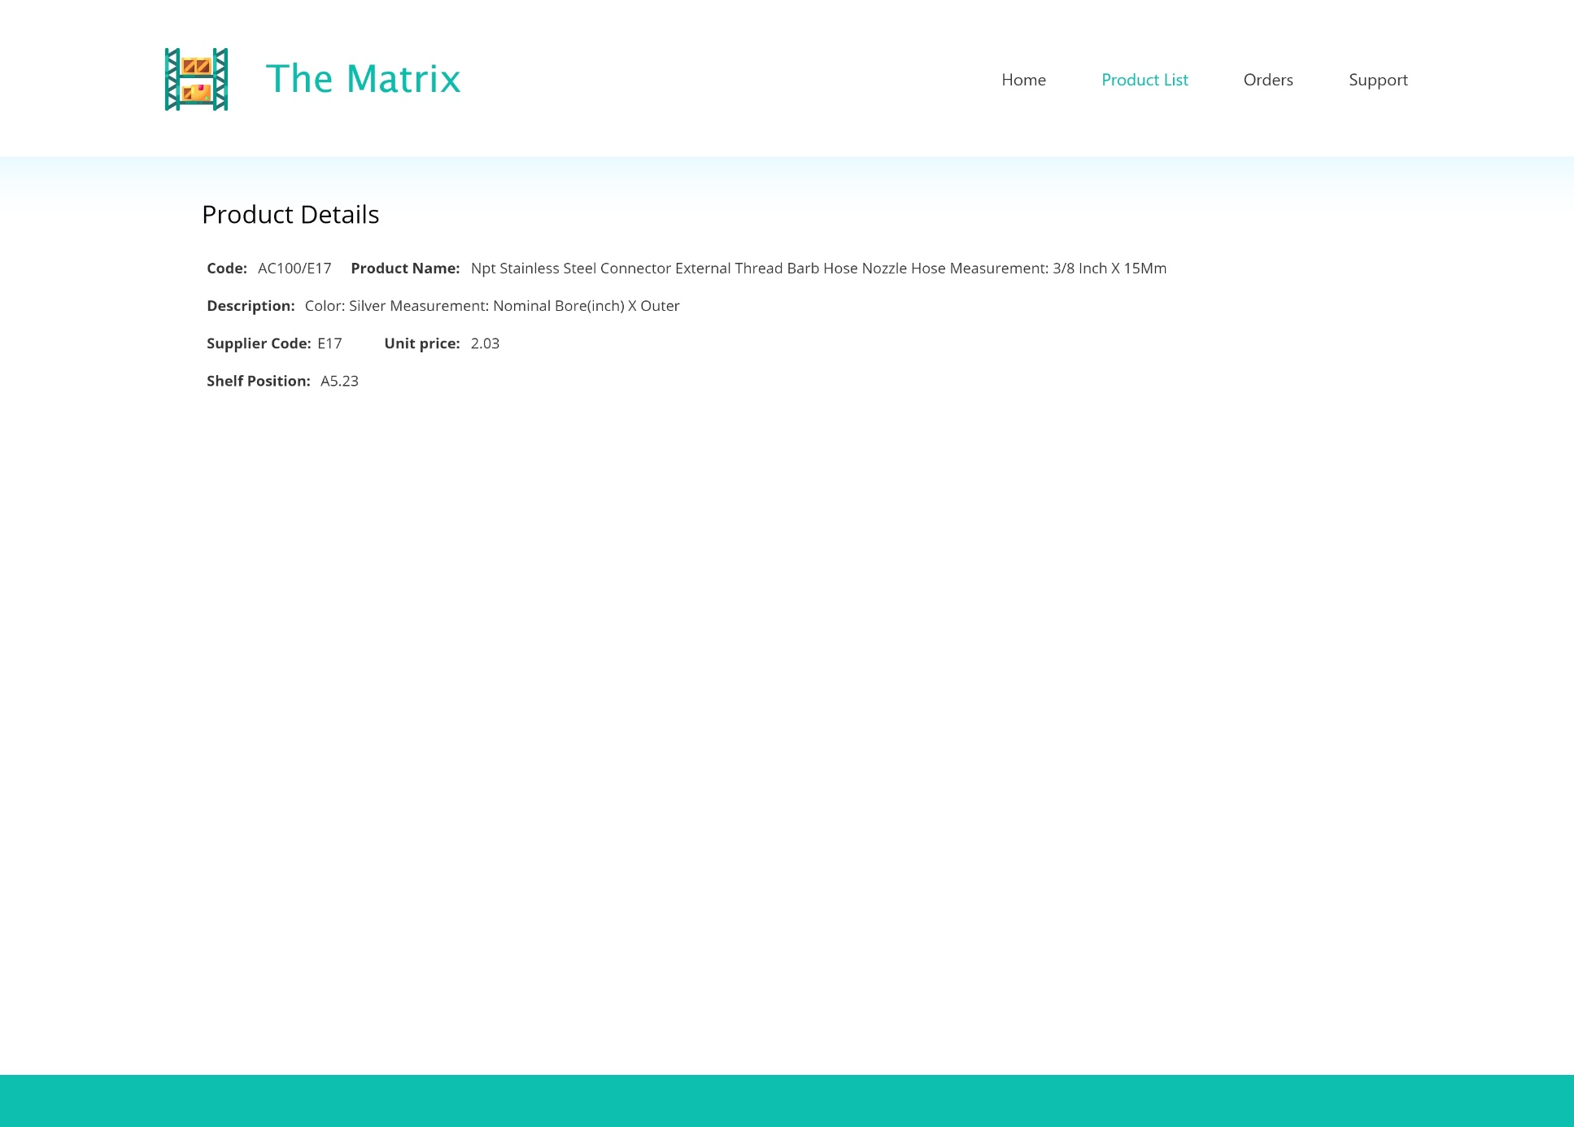
MOCKUP
PRODUCT
DETAILS
PAGE

Slide 8
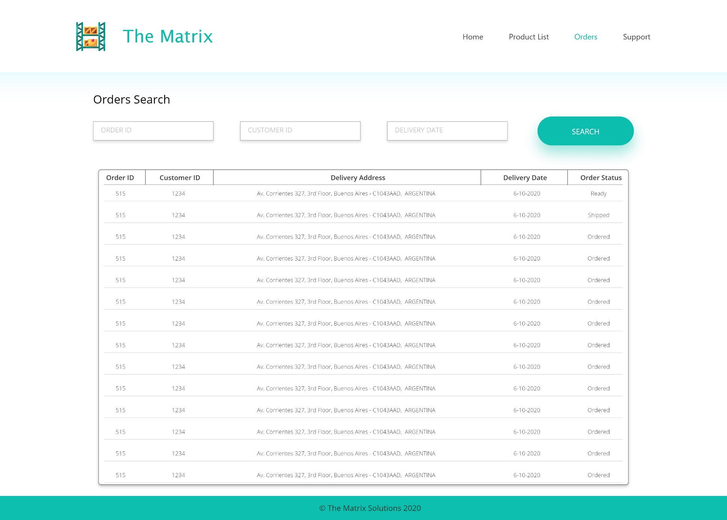
MOCKUP
ORDERS
PAGE

Slide 9
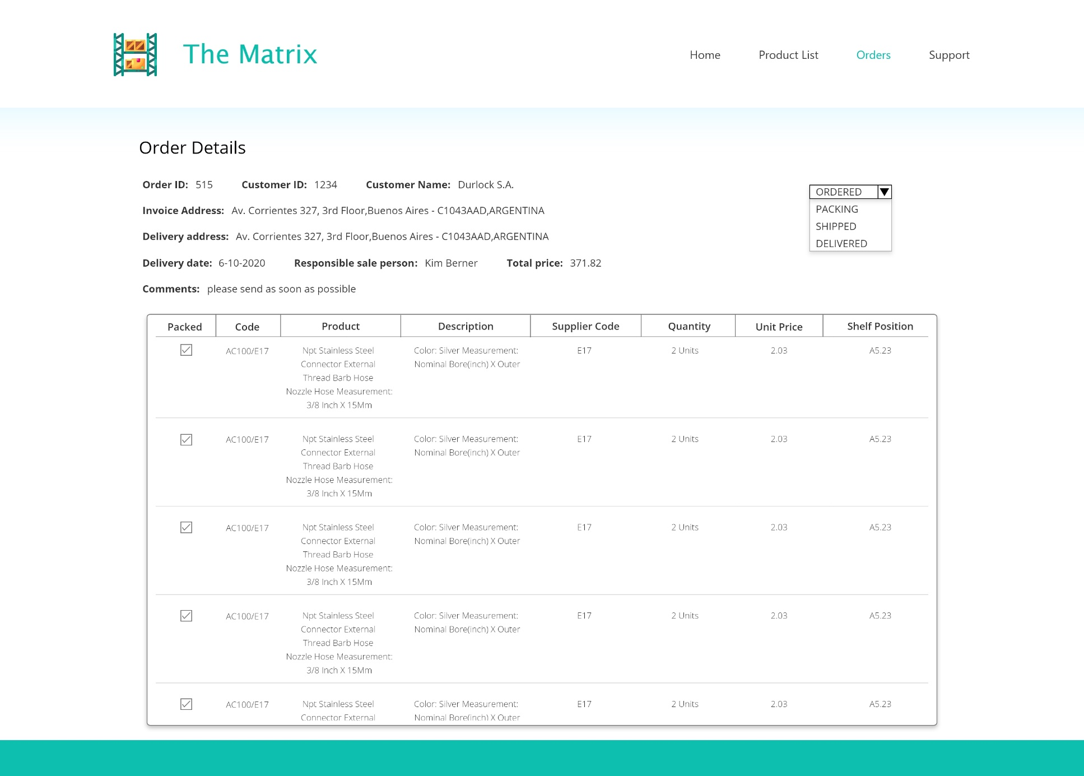
MOCKUP
ORDER
DETAILS
PAGE

Slide 10

OUR PROCESS
Immediately after receiving our brief on the requirements we created our own Microsoft Teams & Whatsapp Groups to have easy means of communication. Then we got started on breaking down the requirements into smaller pieces. We also created a dummy project on GitHub and all joined it as collaborators to test out how to work together with a Version Control system and team development environment. Each of us chose a part we would like to do and we stayed connected via Teams Meetings 3 times a week to keep updated on status of the overall project. We broke up project as follows:
Mykola – Login, Orders & Order Details Page Functionality
Ngoc – Logo Concept Sketch, Products & Product Details Page Functionality
Kunal – Mockup Design, Logo, Front-End Design
Rough over all time estimate from start to end would be 120 Hrs.
TEAM MATRIX

Slide 11









TECHNOLOGIES USED
TEAM MATRIX

Slide 12
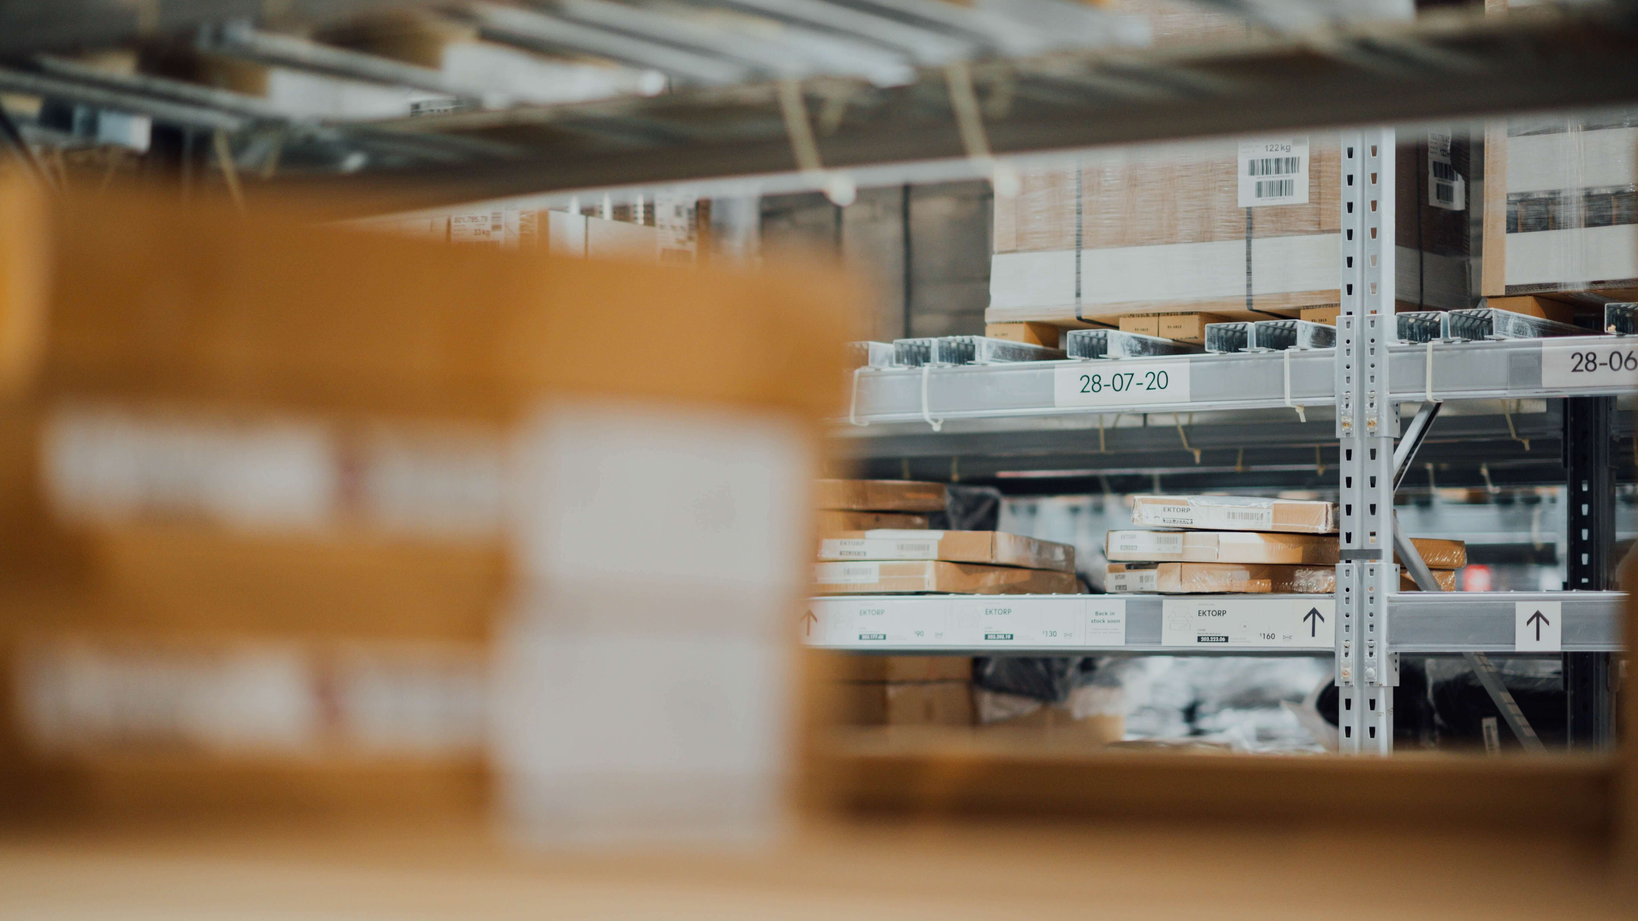
Thank You

